Slide 1

Microsoft Azure
Well-Architected Reliability Assessment

Slide 2


Hello!
Thank you for joining us today
Speaker: Luke Murray
Microsoft Learn Expert and Microsoft Azure MVP, and Senior Consultant from Hamilton, New Zealand.
https://x.com/lukemurraynz
https://www.linkedin.com/in/ljmurray/
https://luke.geek.nz/

Slide 3

Importance of well-architected framework
Cost Optimization
Reliability
DESIGN PATTERNS
Operational excellence
Security
Performance efficency

Slide 4
Importance of reliability
Incomplete procedures
Deferred maintenance
Mixed messages
Inadequate training
Clumsy technology
Production pressures
Regulatory narrowness
Responsibility shifting
Coding
bugs
Attention distractions
Triggers
!
ACCIDENT
THE WORLD
Institution
Organization
Profession
Team
Individual
Technical
LAYERS OF DEFENSE
Why do bad things happen?

Slide 5
Building reliable systems is a shared responsibility
Your application
Your app or workload architecture, built on the below.
Your responsibility:
Reliability ‘in’ the cloud
Resiliency features
Azure capabilities you enable — high availability with Availability Zones, disaster recovery, and backup.
Resilient foundation
Core Azure capabilities built into the platform— how the foundation is designed, operated, and monitored to ensure availability, isolation by Availability Zones and data redundancy.
Microsoft responsibility: Reliability ‘of’ the cloud

Slide 6
Reliability Assessment

Slide 7
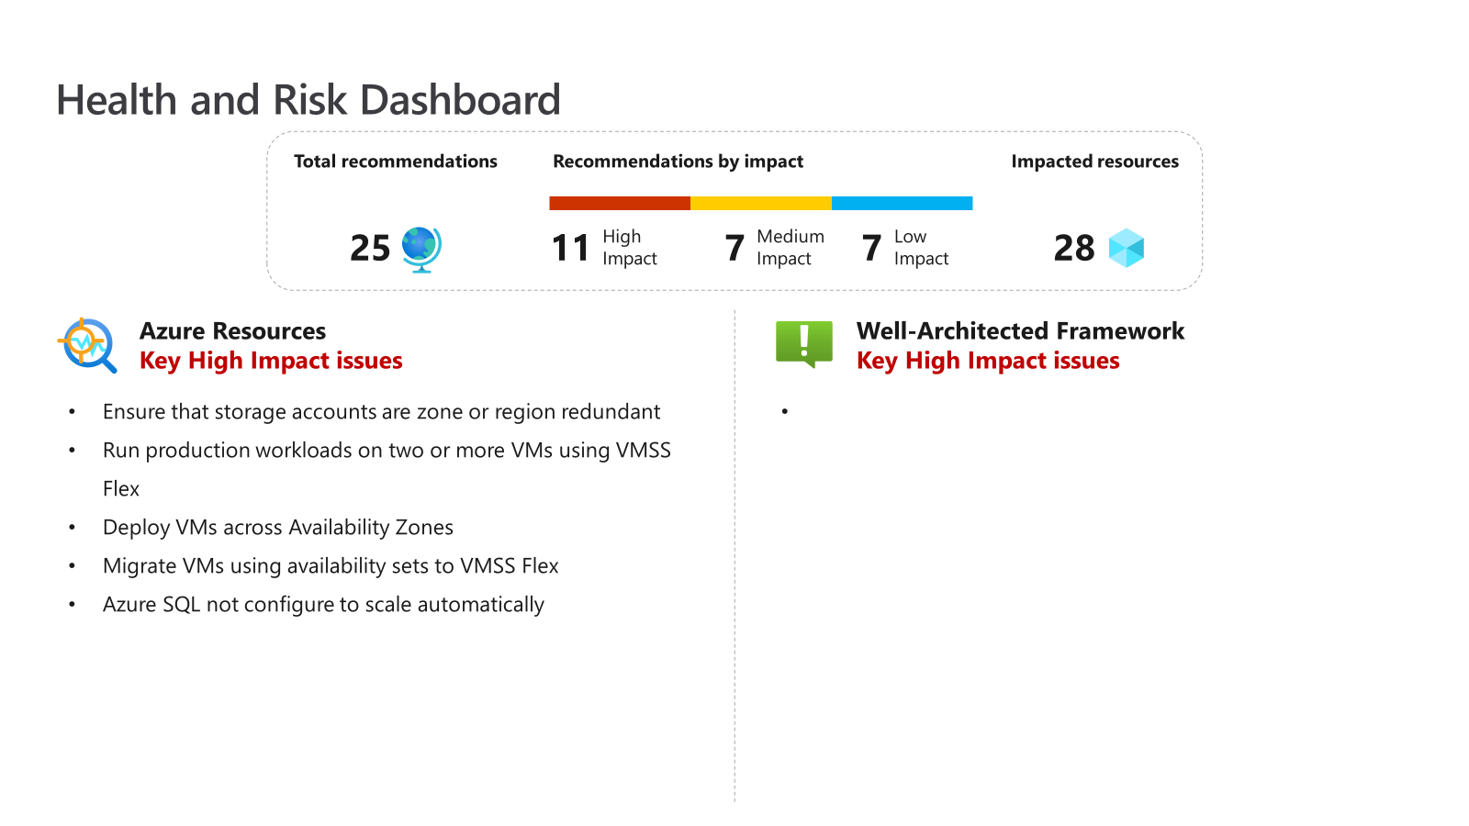
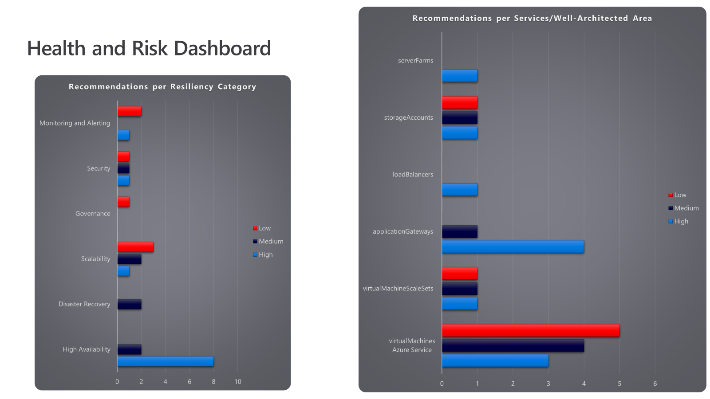
Assessment example

Slide 8
Assessment process
Collect the data
The Collector PowerShell script is designed to collect data from the Azure environment to help identify potential issues and areas for improvement using the Azure Resource Graph queries within this repository.
Analyse the data
The Data Analyzer PowerShell script is the second script in the Azure Proactive Resiliency Library (APRL) tooling suite. The goal of this tool is to summarize the collected data and provide actionable insights into the health and resiliency of the Azure environment.
Create the report
The Reports Generator PowerShell script serves as the final step in the Azure Proactive Resiliency Library (APRL) tooling suite. It takes the Excel spreadsheet generated by the Data Analyzer script and converts it into Microsoft Word and PowerPoint formats.

Slide 9
Architecting for Azure

Slide 10
Architecting for Azure
1
2
3
Cloud Adoption Framework
Azure Architecture Center
Well-Architected Framework
Proven guidance and best practices that help you confidently adopt the cloud and achieve business outcomes.
Guidance for architecting solutions on Azure using established patterns and practices
A set of quality-driven tenets, architectural decision points, and review tools intended to help solution architects build a technical foundation for their workloads.
https://learn.microsoft.com/azure/cloud-adoption-framework/
https://learn.microsoft.com/azure/architecture/
https://learn.microsoft.com/azure/well-architected/

